Slide 1
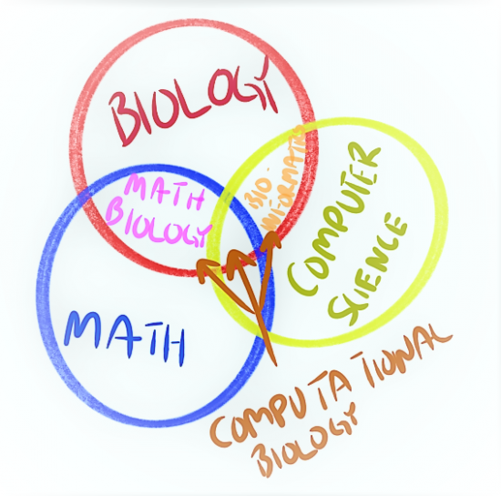
MATH MEETS BIOLOGY
Constraint-Based modeling of metabolism
Iván Domenzain
ivand@chalmers.se
2019-09-24

Slide 2
Learning outcomes
What is a metabolic functional state?
What is flux balance analysis and what are its main assumptions?
Why is the choice of an objective function fundamental for FBA?

Slide 3
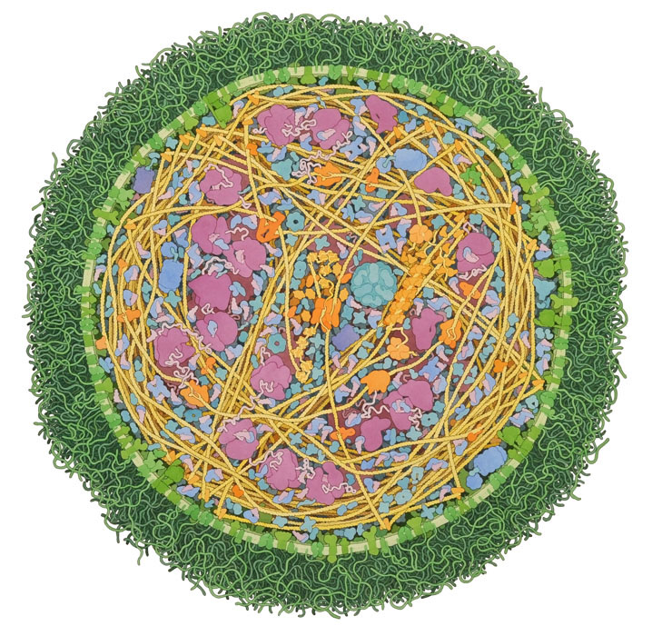
Biological networks

Slide 4
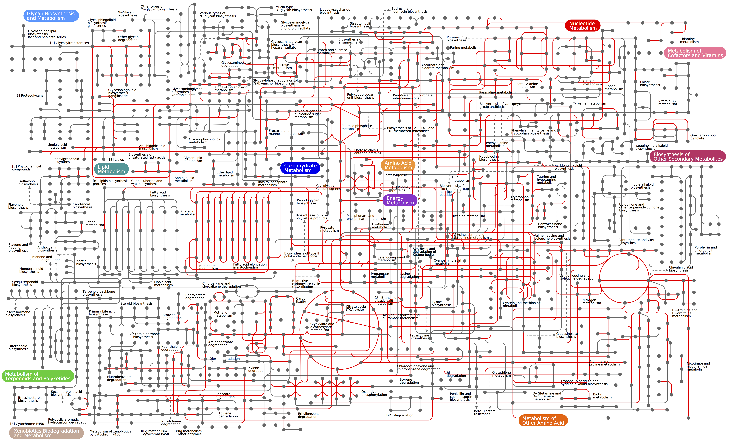
Biological networks

Slide 5
Biological networks

Slide 6
Genome-scale metabolic models
A GEM is a computer model of a real cell. GEMs are based on a reconstruction that contains an accurate chemical representation of all the known components in the corresponding living cells.
GEMs can be seen as biological knowledge databases

Slide 7
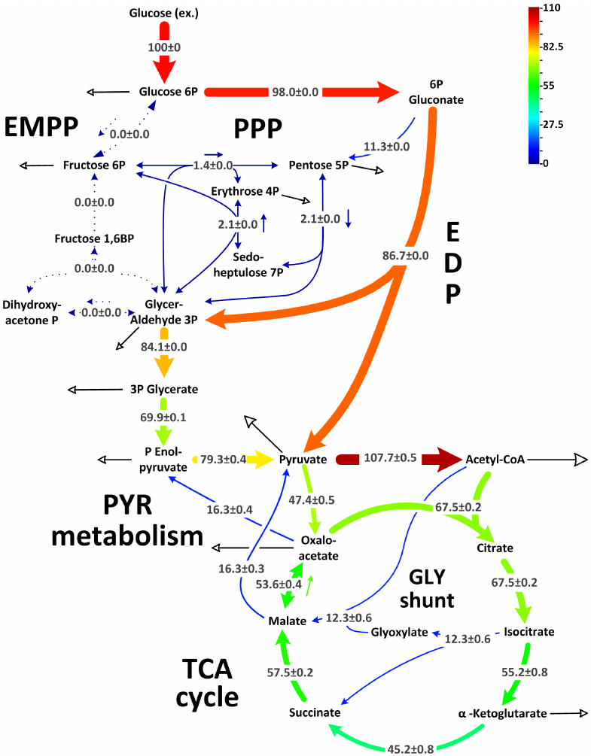
The goal in CBM is to compute fluxes

Slide 8
Functional States
Constraint-based modeling (CB-modeling)
Take home message
A functional state is a given point in the phenotypic space, i.e. any observed phenotype

Slide 9
Functional States
Constraint-based modeling (CB-modeling)
Take home message
A functional state is a given point in the phenotypic space, i.e. any observed phenotype

Slide 10
Constraints

Slide 11
Functional States
Constraining the phenotypic space

Slide 12
Constraints

Slide 13
A simplified framework: Flux Balance Analysis

Slide 14
A simplified framework: Flux Balance Analysis
Take home message

Slide 15
History of FBA
Edwards, J. S., et al. (2002). Environmental Microbiology, 4(3), 133–140. https://doi.org/10.1046/j.1462-2920.2002.00282.x

Slide 16
Mass conservation
Edwards, J. S. (2002). Environmental Microbiology, 4(3), 133–140. https://doi.org/10.1046/j.1462-2920.2002.00282.x

Slide 17
The feasible solution space

Slide 18
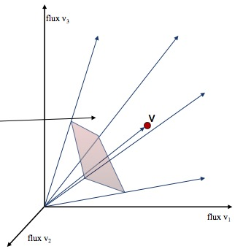
The feasible solution space
The solution space is a convex flux cone
Every steady state flux distribution (functional state) lies within this cone.
At steady state the organism “lives” here

Slide 19
On convexity

Slide 20
On convexity

Slide 21
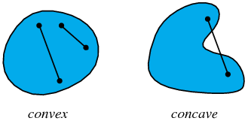
On convexity

Slide 22
On convexity

Slide 23
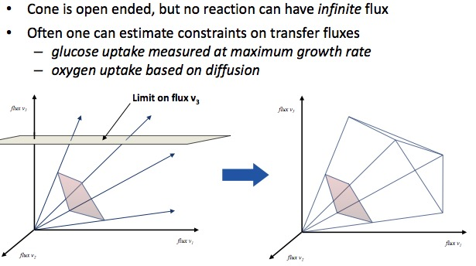
Flux constraints

Slide 24
Flux constraints
At any given time, organisms have a single flux configuration.
A typical GEM has ~1000 metabolites and ~2000 reactions.
How to select one flux distribution?

Slide 25
Flux constraints
At any given time, organisms have a single flux configuration.
A typical GEM has ~1000 metabolites and ~2000 reactions.
How to select one flux distribution?
By assuming that organisms try to maximize a fitness function that is a mathematical function of its fluxes

Slide 26
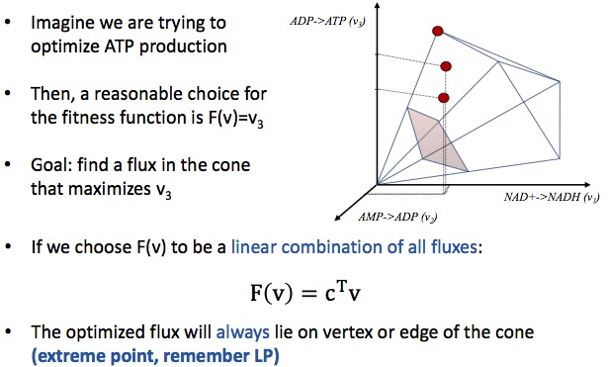
Optimality

Slide 27
FBA: step by step

Slide 28
Constraints

Slide 29
Small scale example

Slide 30
Small scale example

Slide 31
Still interested?
Orth, J. D., Thiele, I., & Palsson, B. Ø. (2010). Nature Biotechnology, 28(3), 245–248. https://doi.org/10.1038/nbt.1614

Slide 32
Objective functions

Slide 33
Objective functions
Biomass pseudorreaction

Slide 34
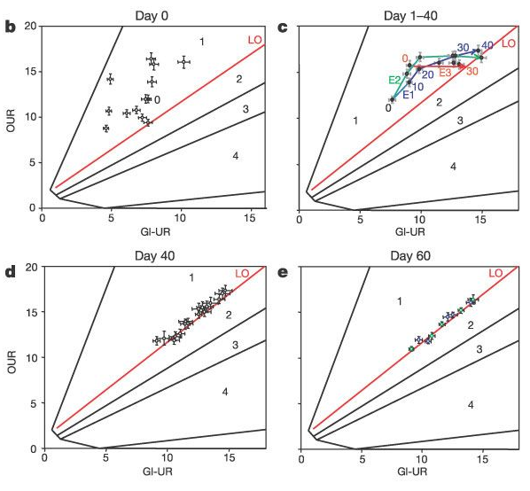

Objective functions
Real biology or just simulation?
Ibarra, R. U., et al. (2002). Nature, 420(6912), 186–189. https://doi.org/10.1038/nature01149

Slide 35
Once again: From GEM to FBA
Thiele, I., & Palsson, B. O. (2007). Introduction to Systems Biology (pp. 14–36). Totowa, NJ: Humana Press

Slide 36
Once again: From GEM to FBA
Thiele, I., & Palsson, B. O. (2007). Introduction to Systems Biology (pp. 14–36). Totowa, NJ: Humana Press

Slide 37
In Silico gene deletions
Patil. Et Al. BMC Bioinformatics, 2005.

Slide 38
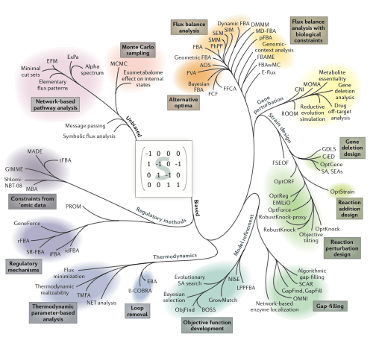
FBA: Just one method in the CBM family
Lewis, N. E., et al. (2012, April). Nature Reviews Microbiology. https://doi.org/10.1038/nrmicro2737

Slide 39
Equivalent states

Slide 40
Flux variability analysis (FVA)
Mahadevan, R., & Schilling, C. H. (2003). Metabolic Engineering, 5(4), 264–276. https://doi.org/10.1016/j.ymben.2003.09.002

Slide 41
Extreme Pathways (ExPa)
Schuster, et al. (2000). Nature Biotechnology, 18(3), 326–332. https://doi.org/10.1038/73786

Slide 42
Alternative Optimal Solutions (AOS)
Phalakornkule, C., et al. (2001). Metabolic Engineering, 3(2), 124–137. https://doi.org/10.1006/mben.2000.0165

Slide 43
Alternative Optimal Solutions (AOS)
Phalakornkule, C., et al. (2001). Metabolic Engineering, 3(2), 124–137. https://doi.org/10.1006/mben.2000.0165

Slide 44
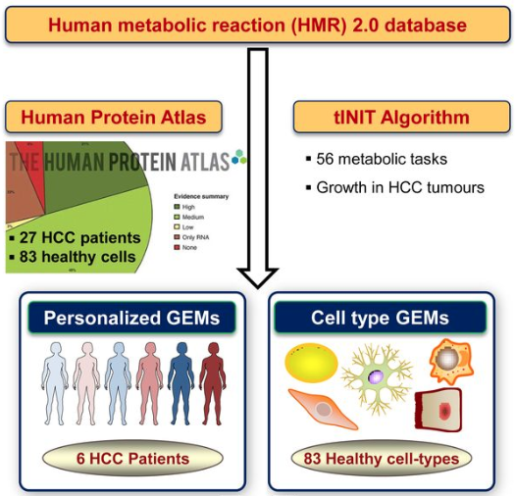
Extending FBA with more constraints
Constraining fluxes with transcriptomics data
Becker, S. A., & Palsson, B. O. (2008). PLoS Computational Biology, 4(5).
Agren, R., et al. Molecular Systems Biology, 10(3).

Slide 45
Extending FBA with more constraints
Constraining sum of fluxes with total enzyme content
Beg, Q. K., et al. (2007). Proceedings of the National Academy of Sciences, 104(31), 12663–12668.
Nilsson, A., & Nielsen, J. (2016). Scientific Reports, 6.

Slide 46
Extending FBA with more constraints
Sánchez, B. J., et al. Molecular Systems Biology, 13(8), 935.

Slide 47
Automated reconstruction of GEMs
Driven by automated annotation of genome sequences
Advantages: Time!
Disadvantages: False positives can be introduced to the network due to annotation inconsistencies. False negatives due to the lack of reported evidence.

Slide 48
Available tools
The COBRA Toolbox
https://opencobra.github.io/cobratoolbox/stable/
https://github.com/SysBioChalmers/RAVEN

Slide 49
Summary
CB modeling is a family of mathematical approaches that uses constraints as the basis for the study of metabolism.
FBA: a type of CB modeling in which an objective function is assumed and optimized inside of the feasible solution space.
Choice of objective function: Fundamental in FBA, several should be tested.
CB modeling is an active research field for biologists, engineers, mathematicians and computer scientists.

Slide 50
Learning outcomes
What is a metabolic functional state?
What is flux balance analysis and what are its main assumptions?
Why is the choice of an objective function fundamental for FBA?

Slide 51
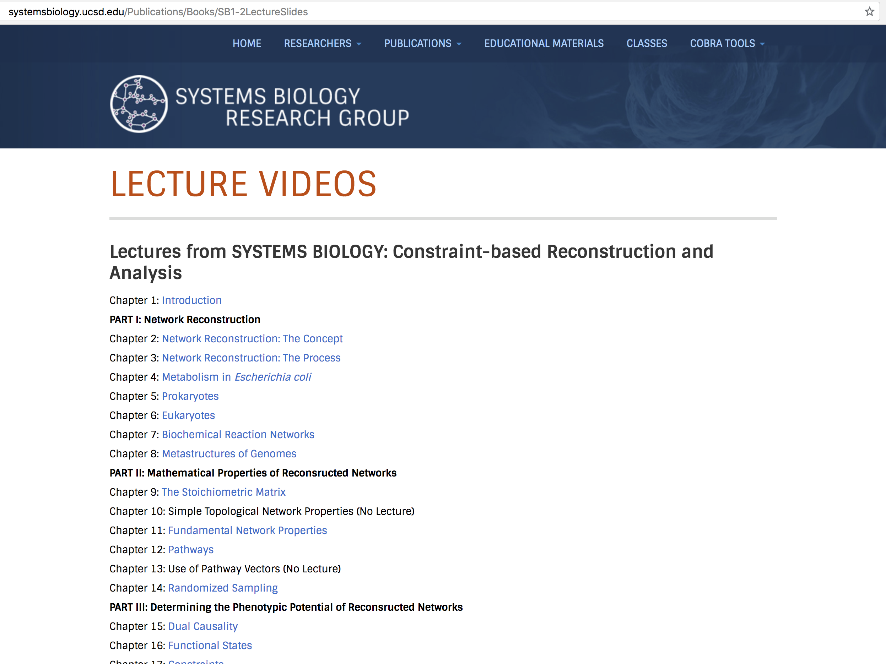
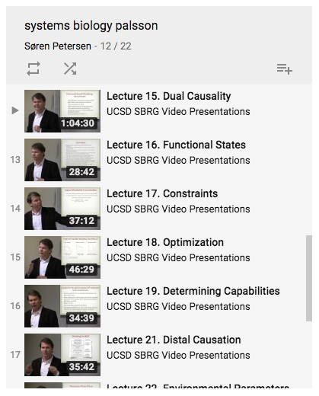
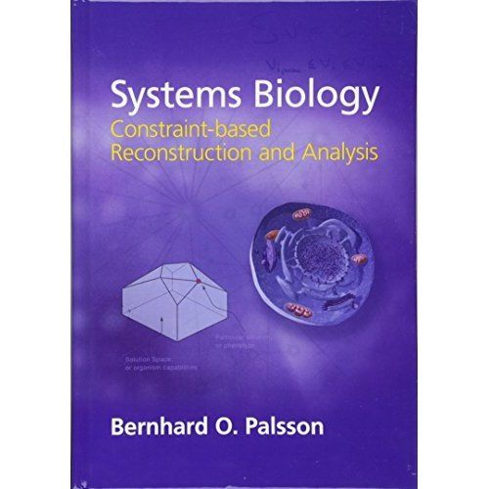
Additional content
http://systemsbiology.ucsd.edu/Publications/Books/SB1-2LectureSlides
https://www.youtube.com/watch?v=tCz-tg4Xmuk&list=PLzm7DNlS3_0hryL9WsVbWV_EkwBJNt9s3&index=12
Course book: Chapters 15-20
Available at: http://www.lib.chalmers.se/

